Slide 1
www.MINEPORTAL.in
ONLINE TEST SERIES FOR
DGMS COAL/METAL FIRST/SECOND CLASS EXAM
GATE MINING EXAM
OVERMAN EXAM TEST
MINING INSPECTOR EXAMS
COAL INDIA MTs & OTHER PSUs EXAMS
FREE STUDY MATERIAL & VIDEO LECTURES
MINING JOBS NOTIFICATIONS
www.mineportal.in Call/Whatsapp-8804777500 www.fb.com/mineportal.in

Slide 2
Determination of Volume and Tonnage
In the office the field data are reduced to horizontal distances and elevations.
The coordinates of the instrument stations in the stope are next determined and plotted by protractor.
Using a protractor (a 5 in. circular celluloid protractor divided to 30 min. is suitable), the draftsman plots the points on the stope map.
Each station is occupied with the protractor, the zero being set on the BS. All of the points for any one setup are located by dots around the periphery of the protractor and the shot number is penciled on the map.
After this is done, the horizontal distances are scaled for each shot and the elevations are pencilled on the map.
In this way the boundary is outlined and the elevations are located. In Fig. (a) the shot numbers are shown for illustrative purposes.
In practice, the first two figures of the elevations to the left of the decimal point would be substituted for the shot numbers.

Slide 3
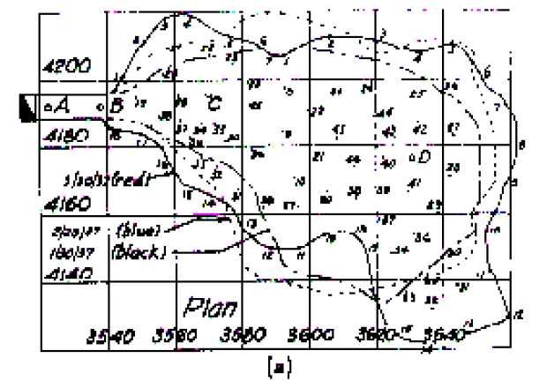

Slide 4
After the plan is completed, profiles or sections are drawn for each coordinate line.
The choice between using east-west or north-south coordinate lines depends on which system will give the most information.
In Fig. (a) the sections are taken along the north coordinate, that is, the line that runs east-west.
The monthly surveys are indicated on the plan and section by different-coloured inks and not by broken lines, as used in Fig. (a).
Usually the congestion becomes so great at the end of six months that a new map must be drawn. All the work is done on tracing cloth or plastic.
A section is made in the following way. For example, section sheet 4180 N as in Fig. (b) is laid along the corresponding coordinate line in the plan and adjusted to its proper relative position by means of known points. (The vertical projection of the north coordinate line on the section is a good way to do this.)
Each elevation occurring on the section line is projected on the section, with necessary interpolation of points falling on each side of the section. These points are connected to give the surface of the broken ore.

Slide 5
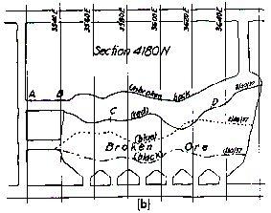

Slide 6
The ore in the slope is that represented by the volume between two successive surveys; for example, 29/02/03 and 30/03/03.
This volume is found by determining the area of each section: arithmetically averaging each two adjacent sections and multiplying by the distance between the sections is satisfactory.
For example, the area of section 4180 N is 1500 sq. ft. and that of 4200N is 2000 sq. ft.
The distance between them is 20 ft.
The volume then is (1500 + 2000) ÷ 2 x 20 = 35,000 cu. ft.
This is not strictly true (formulas used in calculating earthwork for cut and fill would more closely approximate the true value) but is entirely suitable for stope surveys.
Occasionally a section will have to be taken at the boundary of the stope in order to include all of the ore.

Slide 7
Swing Compass Method
An application of the swing compass is shown in Fig.
It is somewhat useful in narrow, irregular slopes where the use of a transit would be difficult.
However, it must be kept in mind that there are very few openings so small that a transit cannot be used then the swing compass can be applied.
The reliability and accuracy of these surveys are very doubtful; they are in many cases much slower than a transit tape survey, and their use is not particularly recommended.
At one time the swing compass was extensively used; at present it is not.
To run this survey, spikes are driven in cracks in the rock or in timber, and a heavy chalk line is stretched between stations.
The compass is placed on the line and the bearing of the line is read. After removing the compass a light protractor is substituted and the inclination of the string is recorded.
With this angle and the SD between nails, the HD and elevations are computed.
It is customary to read the compass at each end of the string. Any magnetic attraction may then be eliminated.
The vertical angle should also be read from each end. Lefts and rights and ups and downs are read at necessary distances along the string.
This survey is usually conducted to give the stope boundary and the back of the ore, and the tonnage is computed on the basis of unbroken ore. The field data are plotted on the map by protractor.

Slide 8
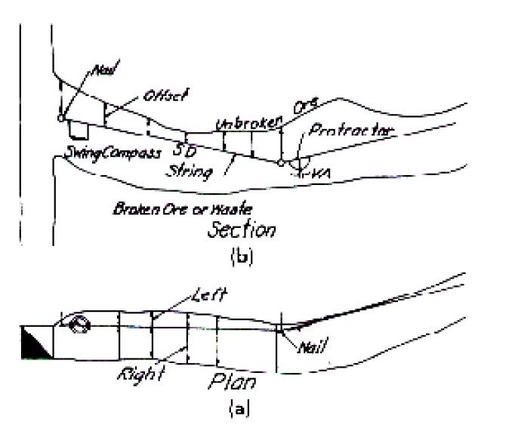

Slide 9
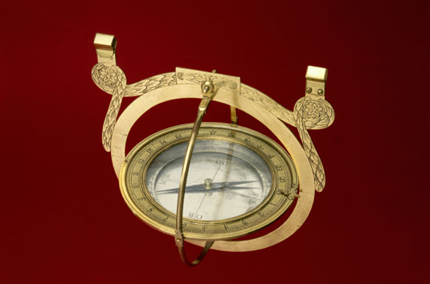
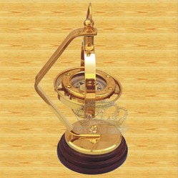

Slide 10
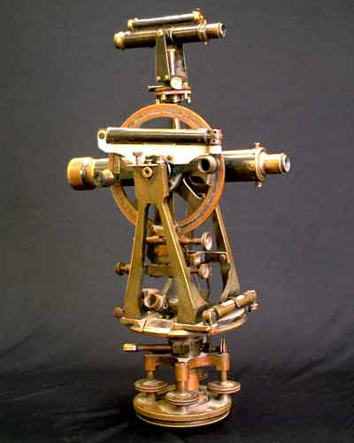
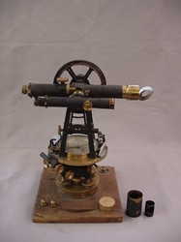
Auxiliary Telescope in Theodolite

